Slide 1
Fair-Chance Employment : The Disparate Impact of Background Checks
September 2016
Nayantara Mehta
Senior Staff Attorney
Berkeley, California
nmehta@nelp.org
Twitter: @NayantaraTweets

Slide 2
Background and National Landscape

Slide 3
With an estimated 70 million adults in U.S. with a record, or nearly 1 in 3 adults, anyone can have a record.
In 2015 poll of prime working age unemployed men, 1 in 3 had a conviction record.
SOURCE: NELP, “Research Summary” (2016), available at www.nelp.org
Notes:
Poll – after talk about the Poll, then Nayantara will ask a clarifying question about the 70 million number.

Slide 4
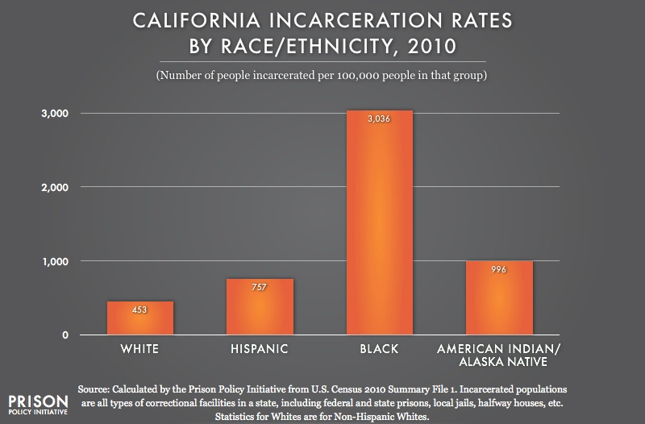
People of Color Disproportionately Impacted by Criminal Justice System

Slide 5
African Americans in California Most Severely Overrepresented

Slide 6
The Devastating Consequences of a Record on Employment

Slide 7
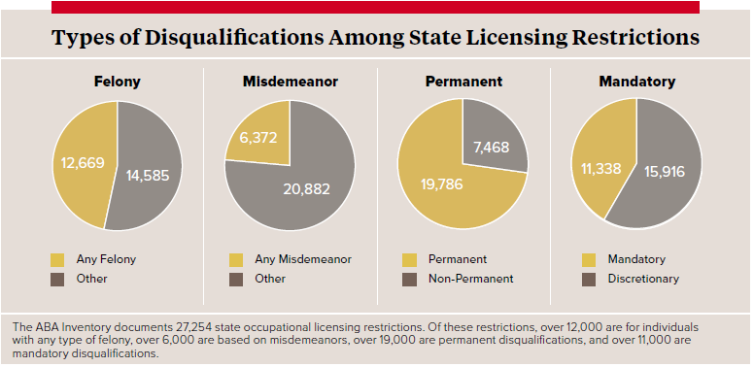
27,254 Licensing Restrictions
Many for any offense. Many permanent. Many mandatory.
SOURCE: NELP, “Unlicensed & Untapped” (2016), available at www.nelp.org (citing the ABA National Inventory of Collateral Consequences, available at www.abacollateralconsequences.org/)
7

Slide 8
How to address this? 1. EEOC Guidance on Title VII and Disparate Impact 2. New California Regulations from DFEH 3. Fair Chance Hiring: Federal, State and Local

Slide 9
EEOC Guidance on Use of
Arrest and Conviction Records (2012)
Do not ask about convictions on job applications.
Do not consider arrests not leading to convictions.
Do not have blanket bans!
3 factors: Consider nature of conviction and job and time passed.
Provide an individualized assessment: Opportunity to explain inaccuracies and circumstances.
Enforcement Guidance on the Consideration of Arrest and Conviction Records in Employment Decisions Under Title VII of the Civil Rights Act of 1964, as amended, 42 U.S.C. § 2000e et seq.

Slide 10
Pending DFEH Regulations
Similar to EEOC Guidelines, goal to avoid disparate/adverse impact on people with records
Requires employers to consider job-relatedness of a conviction: nature and gravity of offense; how long ago offense occurred; nature of job sought.
Requires employers to give notice of the disqualifying conviction and an opportunity for applicant to correct errors.
SOURCE: NELP, “Best Practices and Model Policies” (2015), available at www.nelp.org

Slide 11
Ban the Box Movement
24 States and Over 100 Localities adopt policies
SOURCE: NELP, “Ban the Box” (2016), available at www.nelp.org

Slide 12
Fair Chance Hiring
Ban-the-box on the job application. Remove the conviction history inquiry.
Background checks may be unnecessary for many jobs.
Limit information considered; e.g., avoid considering arrests; dismissed, expunged, or sealed convictions; infractions; or irrelevant convictions.
Delay conviction inquiries until conditional offer. Also, refrain from asking candidates to self-disclose conviction records.
SOURCE: NELP, “Best Practices and Model Policies” (2015), available at www.nelp.org

Slide 13
Resources
13

Slide 14
Learn more from our campaign website, which includes guides, factsheets, model policies and more:
www.nelp.org/campaign/ensuring-fair-chance-to-work/
Additional resource on intersection of background checks and the “on-demand” economy: “Ensuring Fairness in Background Checks for On-Demand Work” (June 2016, Rights on Demand Series)
www.nelp.org/publication/ensuring-fairness-in-background-checks-for-on-demand-work/

Slide 15
National Employment Law Project
75 Maiden Lane, Suite 601
New York, NY 10038
2030 Addison Street, Suite 310
Berkeley, CA 94704
Nayantara Mehta
nmehta@nelp.org
www.nelp.org
©2016 National Employment Law Project. This presentation is covered by the Creative Commons “Attribution-NonCommercial-NoDerivatives” license fee.

