Slide 1
Better Supporting Survivors with a Comprehensive Approach: Trauma-Informed Responses
Emily Austin
California Coalition Against Sexual Assault

Slide 2
Objectives for Today
Understand the impacts of sexual assault
Define trauma and identify signs of trauma
Gain an understanding of the benefits of a trauma-informed approach
Develop skills for responding in a trauma-informed manner

Slide 3
Defining Trauma
What trauma does and what it looks like:
From “what’s wrong with you” to “what happened to you?”
What happens in the brain:
Pre-fontal cortex shuts down and “reptilian” brain (basic needs brain) takes over
Processing and storing of memories is disrupted

Slide 4
The Amazing Brain
From The Amazing Brain, http://www.multiplyingconnections.org/become-trauma-informed/step-3-understand-building-blocks-my-brain

Slide 5
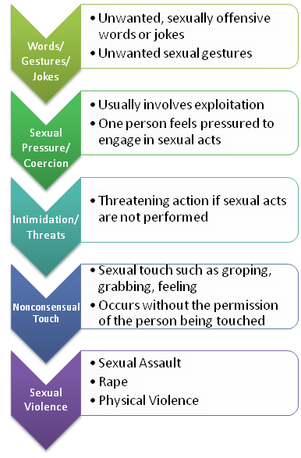
Continuum of Sexual Violence

Slide 6
What Sexual Violence Looks Like
Estimated 1 in 4 women and 1 in 6 men experience sexual violence
25% of women and 10% of men reported that they had experienced sexual harassment at work (Reality Check: Seventeen Million Reasons Low-wage Workers Need Strong Protections from Harassment, National Women’s Law Center, Citing ABC News & Washington Post, One in Four US Women Reports Workplace Harassment (Nov 16, 2011).
60% never report (Id.)
Effects ability to do job, come to job, productivity, morale (NSVRC Sexual Violence & the Workplace, 2013)
Increases health insurance premiums (Bureau of Labor Statistics 2006)
Emotional impacts for survivor and others

Slide 7
Lasting Impacts
From http://danentmacherpsychotherapy.com/trauma-ptsd-treatment/

Slide 8
What does trauma look like?

Slide 9
What does trauma look like?: Rape Trauma Syndrome
nightmares, phobias, fears and lingering physical issues. In addition, she may develop something known as "all or nothing" thinking, such as thinking all men are bad or that she's irreparably damaged.
Longer-term reactions following sexual assault can include depression, anger, shame, and guilt, social and sexual problems
From: American Association for Marriage and Family Therapists, https://www.aamft.org/iMIS15/AAMFT/Content/Consumer_updates/Rape_Trauma.aspx

Slide 10
Addressing trauma you’ve experienced
Recognize the far-reaching impacts of trauma—there are several people in most groups that are survivors sexual violence
This a personal and political issue
Every audience has survivors of sexual assault or those impacted by sexual assault

Slide 11
Best Practices
Understand the nature of sexual violence
Be trauma-informed
Form collaborations and partnerships
Support and model bystander cultural shifts

Slide 12
Why survivors don’t report
Shame
Self-blame
Cultural blame/victim blaming
Won’t be believed
Discrimination
Worried about impact on relationships
Worried about impact on job, status
Control
Fear

Slide 13
Impacts of Sexual Assault
Changes in how we view trust
Anger and blame
Shock
Numbness
Loss of control
Disorientation
Helplessness
Sense of vulnerability
Fear
Self-blame/guilt for "allowing" the crime to happen
Feeling that these reactions are a sign of weakness
See more at: http://www.joyfulheartfoundation.org/learn/sexual-assault-rape/effects-sexual-assault-and-rape#sthash.rGVNHyf4.dpuf

Slide 14
Trauma-Informed
See the whole person and whole needs
Actively resist re-traumatization
View the whole systems and process—trauma-informed beyond the individual response
Treat the survivor as the expert in her/his own trauma

Slide 15
Trauma-Informed
What this means for system change
Work climate changes
Transparent/accessible procedures
Survivors of trauma have their memories impacted, their ability to reflect on what happened to them
Not treat the victim/survivor as a witness to their own crime

Slide 16
Tips of the a Trauma-Informed Response
Listen and let the story unfold
Simple interventions
Options and choices
Self-care and Safety plans
Strong support networks

Slide 17
Listen and Let the Story Unfold

Slide 18
Simple Interventions

Slide 19
Options and Choices

Slide 20
Self Care and Safety Plans
Notes:
fromL http://www.edutopia.org/open-educational-resources-guide

Slide 21
Strong Support Networks

Slide 22
How can you support survivors?
Believe them
Listen to their needs
Connect them to confidential resources
Do not push one option—let the survivor choose what is best for him/her
Safety plan
Talk about reasonable accommodations

Slide 23
Trauma-Informed Investigations of Sexual Harassment and Assault
Listen
Acknowledge the trauma
Support person
Let the survivor decide
Help through offering resources
Mental/emotional
Medical
Legal
Job based
Help the survivor gather facts/document/remember
Active listening, limit the cross-talk
Explain that certain information will make a stronger case:
Facts as to the timeframe, pervasiveness, severity of harassment
Identifying the harasser, confronting the harasser

Slide 24
Resources
Support for Survivors:
http://www.calcasa.org/wp-content/uploads/files/CALCASA-1999_Support-for-Survivors.pdf
Workplaces Respond:
http://www.workplacesrespond.org
National Sexual Violence Resource Center:
http://www.nsvrc.org/projects/sexual-violence-workplace/sexual-violence-and-workplace-onlince-special-collection

Slide 25
Questions?

Slide 26
Emily Austin, JD
Director of Advocacy Services
eaustin@calcasa.org
(916) 446-2520

